Slide 1



Adult Head Model

Slide 2
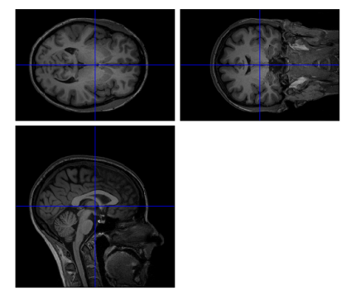
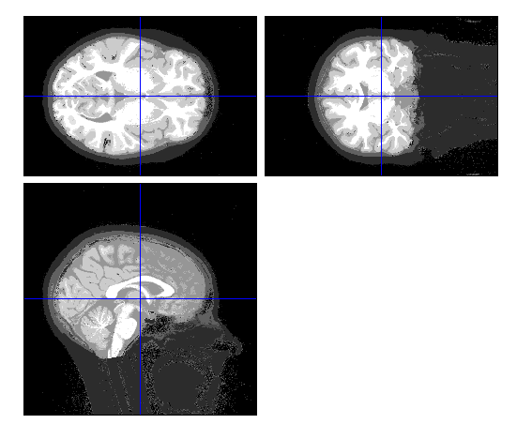
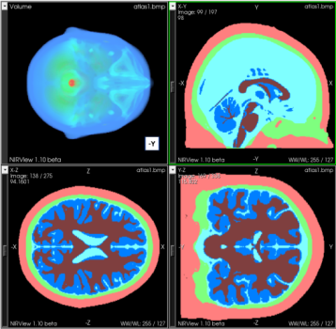
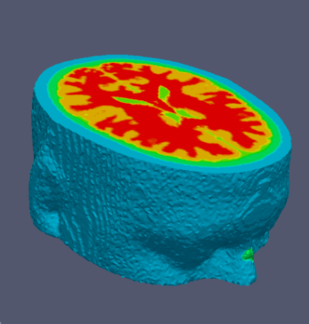
Model Creation and discretisation
MRI scans
SPM
Segmented
scans
NIRFAST-Slicer
Masks
NIRFAST
Volume Mesh
SPM: Statistical Parametric Mapping http://www.fil.ion.ucl.ac.uk/spm/
Meshing based on the computational geometry algorithms library (CGAL) implemented in NIRFAST: http://www.nirfast.org

Slide 3
3D segmented mask
MRI
Tissue PDF
segmentation

Slide 4
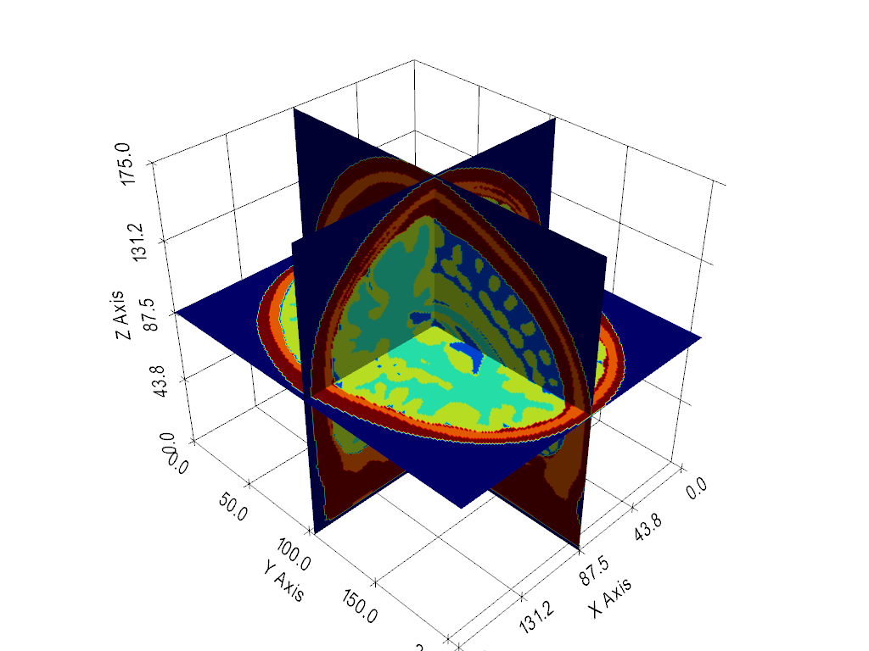
3D segmented mask
Save as a 3D array, each voxel having a label (0-5) with 0 = air
Voxel size 1mm³

Slide 5
Optical Properties
Region | HbO (mM) | Hb (mM) | Sa (mm−1) | Sp
Skin | 0.0575 | 0.0313 | 0.53 | 1.15
Skull | 0.0443 | 0.0195 | 0.72 | 0.89
CSF | 0.0110 | 0.0083 | 0.30 | 0
Gray matter | 0.0559 | 0.0350 | 0.50 | 1.73
White matter | 0.0680 | 0.0265 | 0.81 | 1.31
Can convert to absorption and reduced scatter at any wavelength using Extinction Coefficients and Mie’s Theory

Slide 6
Meshing parameters
Adjust meshing resolution: smaller, higher density, typically ~1
  Assuming voxel size of 1 mm in 3D mask
Higher density
  Numerical stability
  Longer computation time

Slide 7
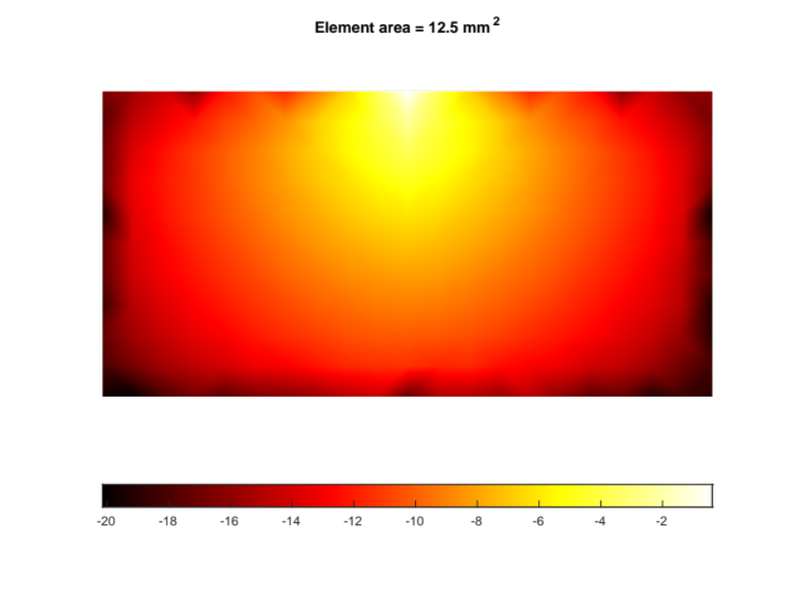
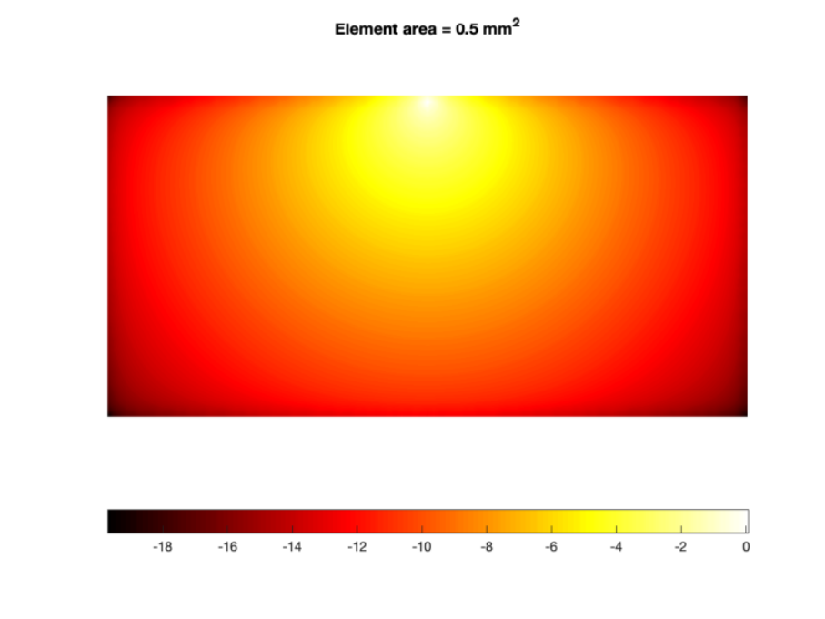

Meshing resolution
Error tends to zero as elements get smaller

Slide 8
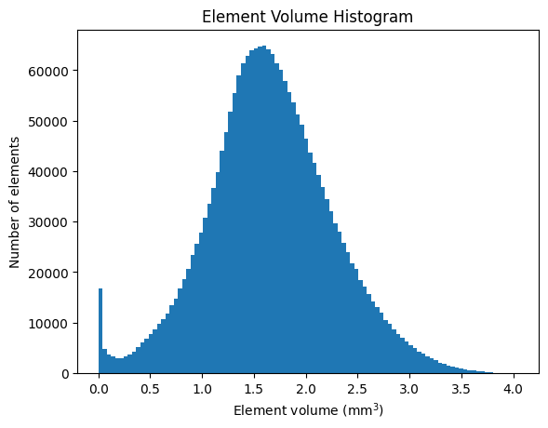
Meshing Quality
Ensure a nice distribution of element sizes
  Avoid a bi-modal distribution

Slide 9
Questions?

